Slide 1

Building Effective Fantasy Hockey Models: A Case Study
Michael Wood
Springboard Data Science Capstone 1
April 2019

Slide 2
Why Fantasy Hockey?
Fantasy sports is an exploding industry, with fantasy football alone estimated to be worth $7 billion in 2017 and some estimates project it might be as high as 15 billion total¹. Models have existed in other sports to predict overall player performance since at least 2003, the most notable example being Baseball Prospectus’ PECOTA, but thus far NHL lacks a similar standard.
For this case study I took the ESPN fantasy league that I play in as a guide, and built a number of models using various tools from python's scikit-learn packages, the objective being to build a model that will perform at least as well as a human in the current league, and create something saleable to the hobbyists².

Slide 3
Data Collection
All data was collected from Natural Stat Trick an invaluable resource curated by Micah McCurdy³, who compiles all kinds of data from the National Hockey League. There was minimal preprocessing required due to sanitation efforts by McCurdy.
The next few slides are devoted to the process of feature tuning and initial analysis, but a detailed look can be found on my github, here:
https://github.com/mhbw/springboard/blob/master/Capstone%201/

Slide 4
Preprocessing And Feature Tuning
Given the specialty nature of this data set there are few missing values. The notable exception is Draft information, as a number of players were undrafted; this information is important and does correlate to value in some ways, so the goal was to retain it in some form or fashion. After consideration, it was decided to make this a number higher than possible, 1000, which would make it similar to being drafted last instead of making it 0 and close to 1, which is the highest draft ranking.
Draft Year was made into 1900, and team is now 'Undrafted’.
As far as other missing values a logic was applied that can be boiled down to "if a player had an NA value due to not getting any points, they are marked zero, if they are NA due to having the opportunity to play in those events, they are returned to the mean.”
Some pointless or redundant columns (power play position, etc) were dropped wholesale.

Slide 5
Preprocessing And Feature Tuning
Age curves are much discussed in the analytics community⁴, so an age metric was created.
Our target metric, Fantasy Points Per Season, is not baked into the data so that was generated, as well as Fantasy Points Per Game and Per 60 Minutes Played.
Additionally some total time metrics were added in.

Slide 6
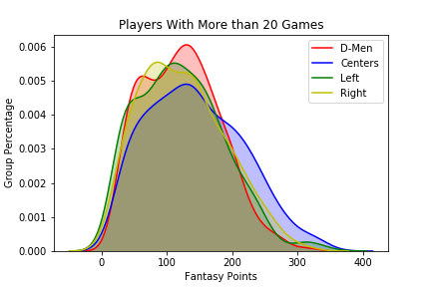
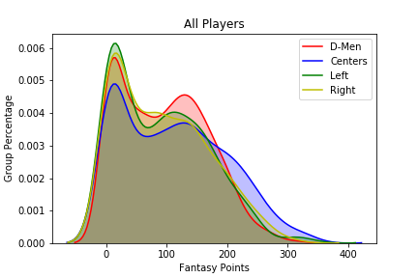
Data Exploration
Two Key Points From Data Exploration:
Fantasy Points are evenly distributed, with the mean of 100 points; this is more pronounced when narrowed to players on permanent contract and those with trial periods (less than 20 games)

Slide 7
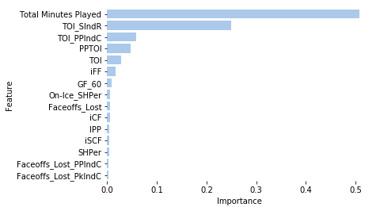
Data Exploration
2. Time is perhaps the most important variable and correlates highest with total points. The chart here is of the correlation to fantasy value. (TOI indicates, ‘Time On Ice’ metrics, CF and FF are Fenwick and Corsi: measures that indicate puck possession)

Slide 8
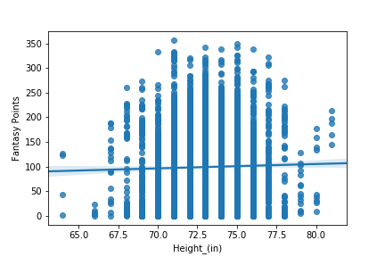
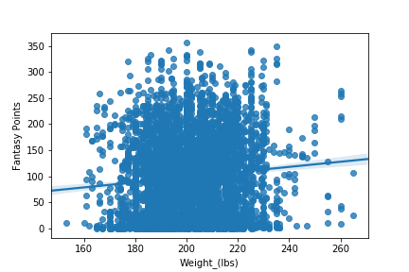
Data Exploration
This is was not a goal of this analysis but it’s interesting to see how little height and weight seem to effect value; note that height seems to do nothing to the correlation line. This is counter to the common narrative that ‘small undersized players can’t compete’.

Slide 9
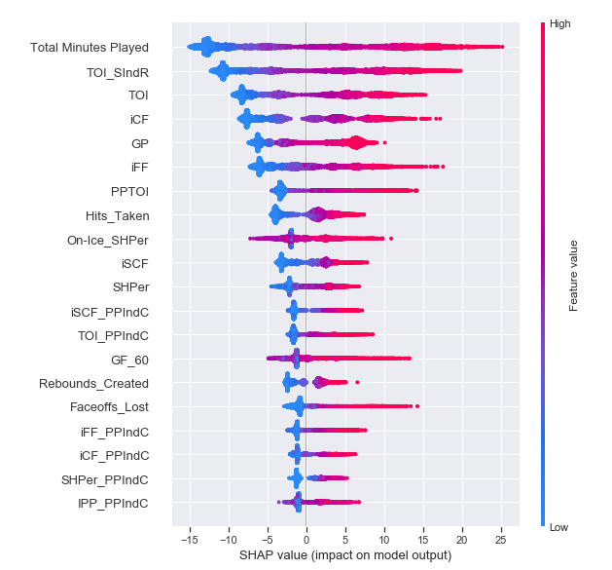
Model Building
This is a chart of SHAP values. These values represent 'a feature's responsibility for a change in the model output'. So for example, Time On Ice can change a players point total by as much as 40 total points, -15 points in some cases, and as high as +25 for some players. This gives a tangible snapshot of how features impact the model's output.

Slide 10
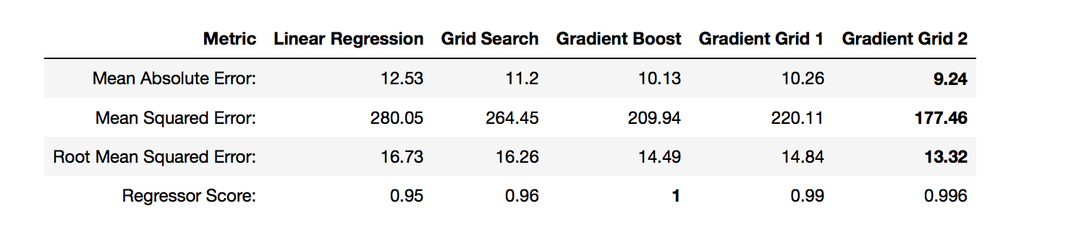
Model Building
three classes of models were attempted, starting with the classic linear regression, then more advanced ensemble models such as Random Forests and Gradient Boosted Regressors. Grid search was employed to tune the models Below are the error rates for the respective models:
As you can see the gradient boosted model performed the best, with a strong regressor score and low error rates. There is evidence that these could further improve by increasing the number of estimators but it became computationally costly compared to the return and so was stopped at 600.

Slide 11
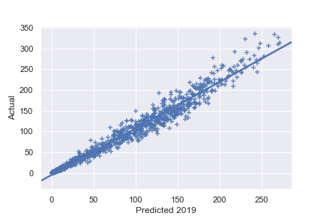
Application
So how does this perform in the wild? The model was compared to an actual ESPN league from 2019. This is a plot of the model against the actual results for 2019: as you can see the line of fit is very tight across the board.

Slide 12
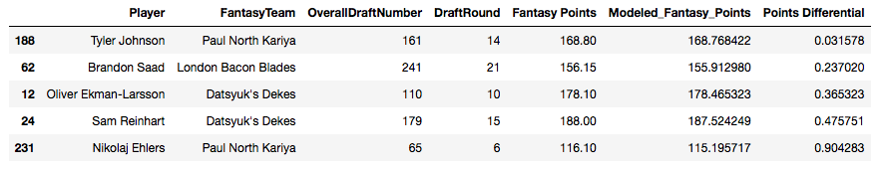
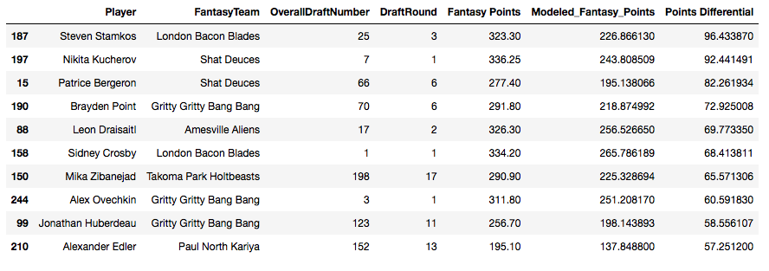
Application
This is a comparison of those the model was closest to the mark with and those that were the furthest away. Close:
Far:
What this shows me here is that the model over all does very well, especially at the mid point, and does poorly with the outliers. Those folks at the top are mostly the top of the league as well, in almost that exact order: Kucherov, Stamkos, Draisaitl, Ovechkin. Outliers in terms of performance both in the model and real life.

Slide 13
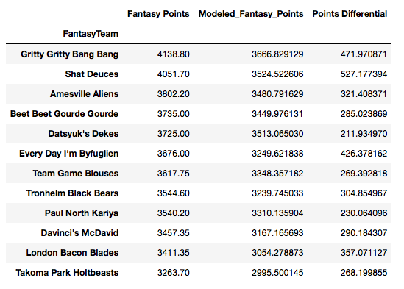
Application and Extensions
If this model had been used in this league the shift would have been relatively minor. Only two teams would have shifted position significantly if they’d followed it and it were correct.
This isn't a huge surprise, but does speak to some accuracy since the margin in some of these was as slim as 4 points in the actual and 10 in the modeled, or less than 1/1000 of the top score.
This model would benefit from a few things in future iterations, namely a reduction in time features, and secondly a normalization and scaling of the features. The noise in the features could be reduced by normalization which would reduce the volatility.

Slide 14
Conclusions
This type of model could be a valuable product as an introductory primer, and could be marketed to new players. For example London Bacon Blades was managed by a new NHL fan who had only watched one season before this. The manager drafted two of the top over all performers but dropped off dramatically and finished in 11th out of 12 teams. Had they had such a product, they would have perhaps been better able to make experienced moves like Takoma Park Holtbeasts; a former player who has won the league. This type of manager would likely also be willing to spend for a guide based on said model, which as noted in the first slide, is a massive market.
Most importantly, this capstone shows that while it is most the outcomes of hockey games are perhaps the toughest sport to predict it is possible to model player performance⁵. Despite being somewhat conservative the model did well on an overall basis as seen in slide 10.
Both of these findings show that there is real value in the model and the product, and machine learning can lend tangible insights in a difficult field.

